Slide 1
COURSE 1 – EXCEL REASSESSMENT
AKILAN BIMBY ANNADURAI
EMP ID : 4349
ILMS ID: LVADSUSR141

Slide 2
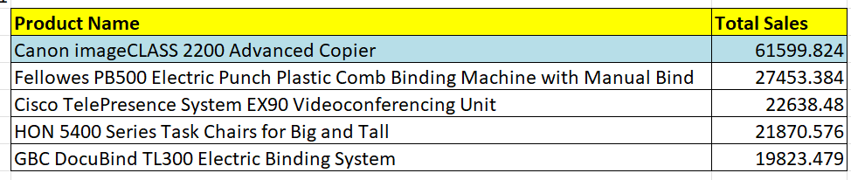
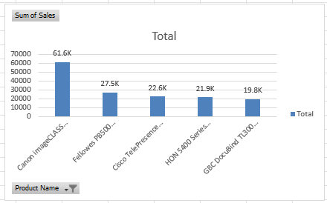
1)Use a Pivot Table to list top % products by sales.Which product had the highest sales?
INSIGHTS:
Using pivot the product name and the sum of sales were found .
Then order the sales in desc order to find the top sales value.
Filter is made using value filter to find the top 5 product
Canon imageCLASS 2200 Advance Copier is the top sales product

Slide 3
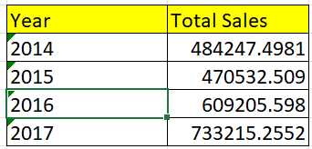
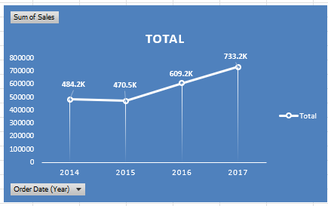
2)Create a line graph to analyse the trend in total sales over the years.Is there a year with a noticeable increase or decrease in sales?
INSIGHTS:
Using Pivot,The year from the order date is calculated and the total sales is also found.
With the value we created a line graph from where we can see the trend of the sales over year.
During the year 2015 the sale slightly decreased but it increases gradually after that.
Year 2017 have the maximum sales.

Slide 4
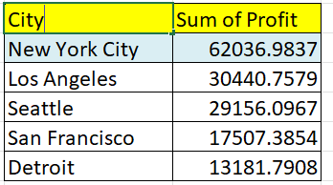
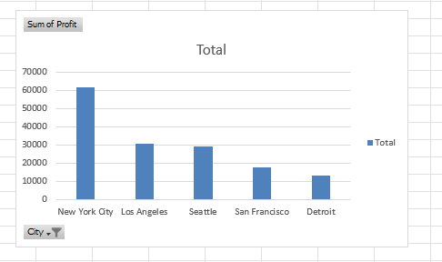
3
INSIGHTS:
Using Pivot,we found the sum of profit for each city and the new York city ids the most profitable city
We used bar chart

Slide 5
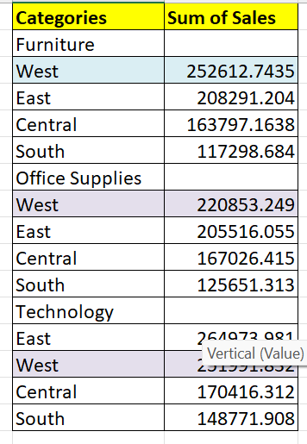
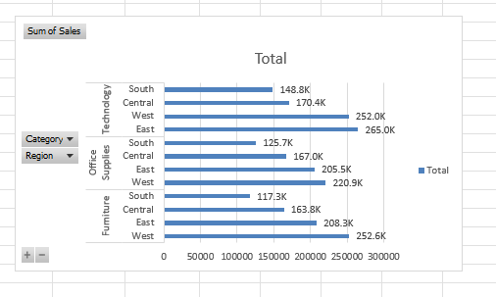
4
INSIGHTS:
Using Pivot,we found the category value for each region and its sum of sales
Furniture have the most sum of sales in the west region.
We used bar chart

Slide 6
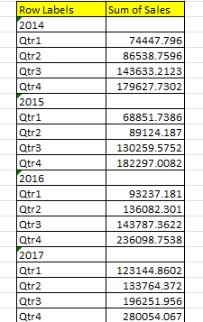
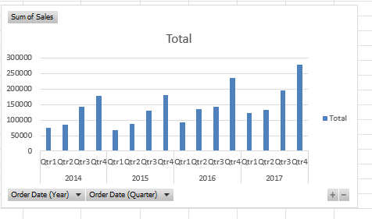
5
INSIGHTS:
Using Pivot,The year from the order date is calculated and the quarter also found .
Q4 have the most sum sales in the total sales and its come in 2017
We used coluimn chart

Slide 7
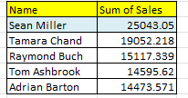
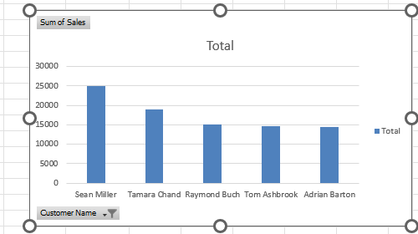
6
INSIGHTS:
Using Pivot,we found the name of the customer and the sum of sales value .
Sean Miller is the top sales person.

Slide 8
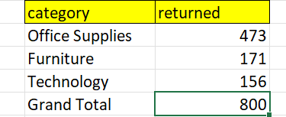
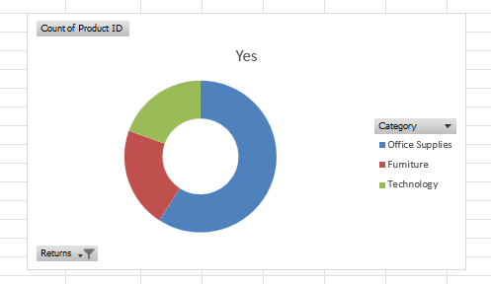
7
INSIGHTS:
Using Pivot,we found the returned category value
The office supplies returned 473 values

Slide 9
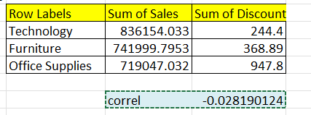
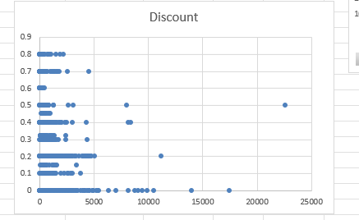
8
INSIGHTS:
Using Pivot,the sum value and the discount is found
By that we can see the sum increases when the discount dicreases
The correl value is -0.028190
It is negavitily weak correlated

Slide 10
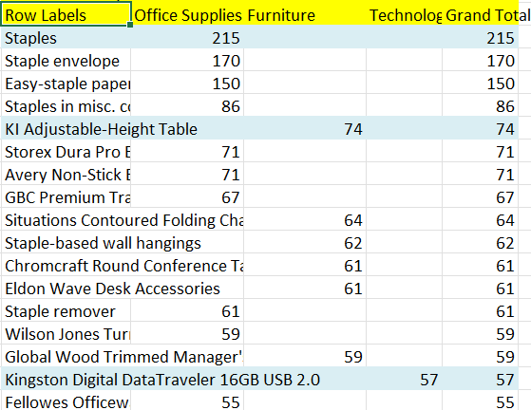
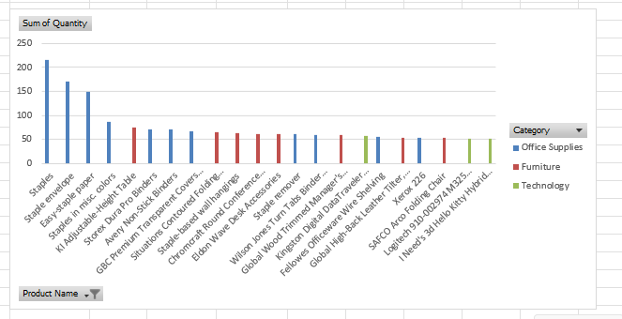
9.Most famous product in each category
INSIGHTS:
Using Pivot,we found the category and its product value
The staples is most in the office supplies
Ki adjust,ent is most in the furniture
And Kingstone is mosy in the technology

Slide 11
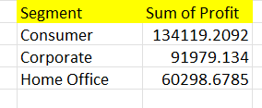
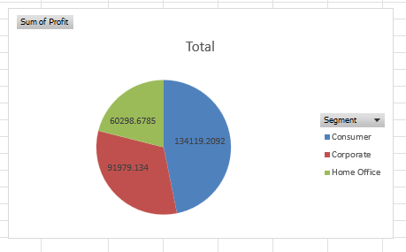
10.Sales Performance by segment
INSIGHTS:
Using Pivot the segment and sum of profit is found
Pie chart is used to find it.
Consumer have more profit value

Slide 12
